Slide 1



Amazon Product Rating and Review Analysis
Group 1:
1. Shiva Kotagiri 2. Rohith Reddy Kolanu 3. Vineet Reddy Saddi 4. Prakash Sai Alla 5. Pratham Patel

Slide 2
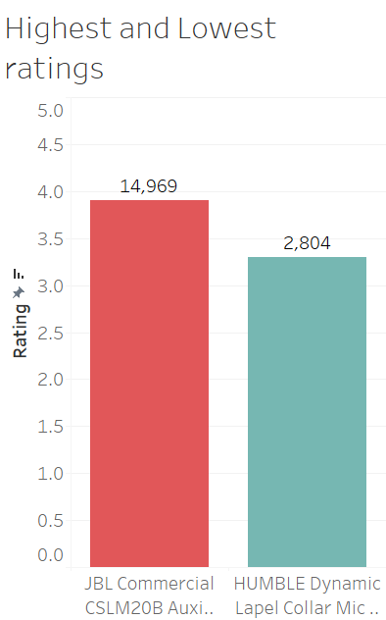


1. Which products have the highest and lowest ratings within each category?
The chart compares the ratings and number of reviews for two microphones in the "Audio & Video Accessories | PC Microphones" category. It highlights the JBL Commercial microphone as having the highest rating (14,969 reviews) and the HUMBLE Dynamic microphone with a comparatively lower rating (2,804 reviews). The visualization aims to understand customer preferences and product popularity.

Slide 3
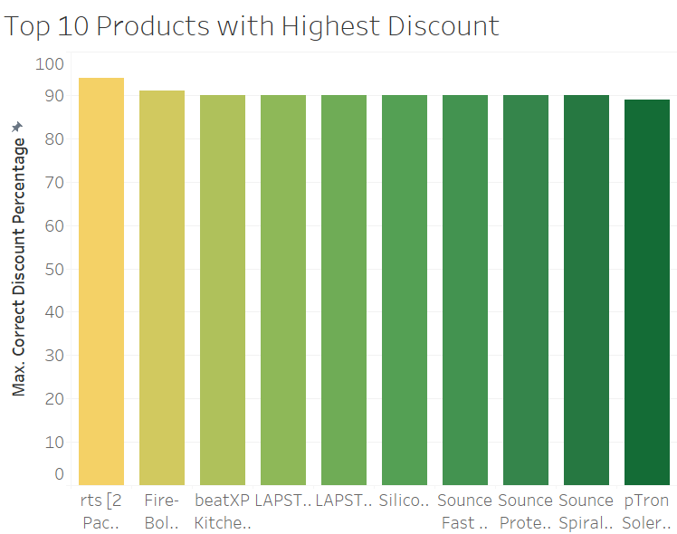
2. What is the distribution of discount percentages across all products?
The bar chart displays the top 10 products with the highest discount percentages on Amazon. The data provides insights into maximum discounts offered across various product categories, helping identify the most budget-friendly options for customers.

Slide 4
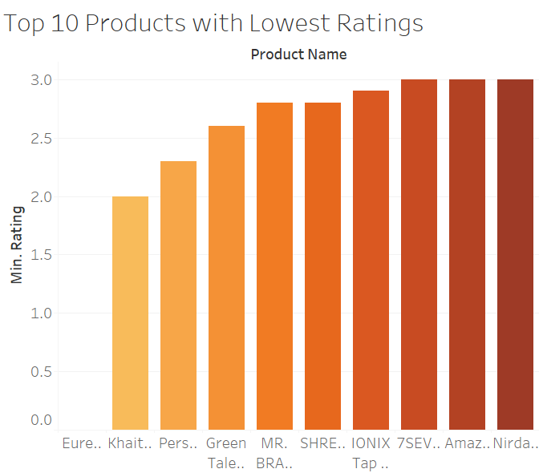
3. What are the top 10 lowest-rated products, and how do their ratings compare?
This bar chart illustrates the 10 products with the lowest customer ratings on Amazon. The data highlights products with poor performance in customer satisfaction, providing insights into items that may require quality improvements or better customer engagement.

Slide 5
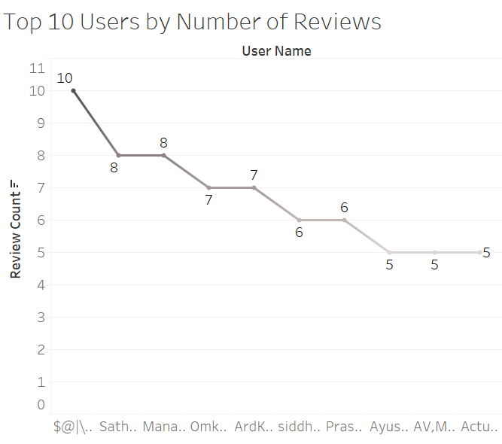
4. Who are the top 10 users by the number of reviews, and how many reviews have they submitted?
This line chart shows the top 10 Amazon users with the highest number of product reviews. It highlights the most active reviewers, showcasing their contributions to product feedback and customer insights.

Slide 6
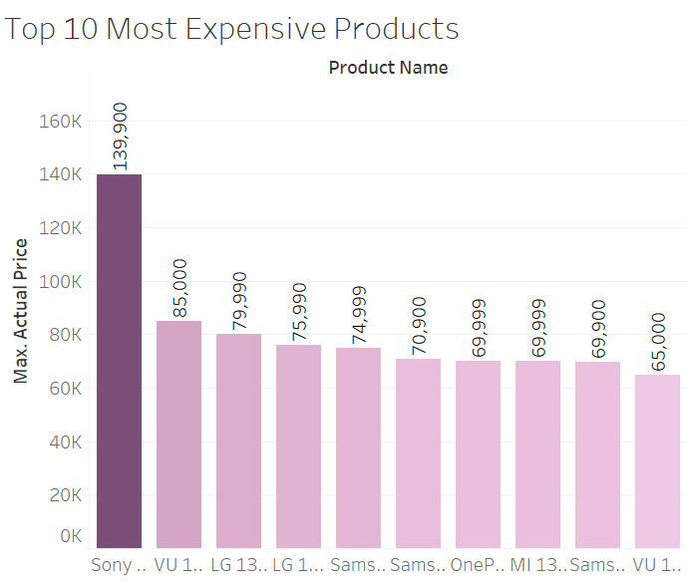
5. What are the top 10 most expensive products, and how do their prices compare?
This bar chart highlights the 10 most expensive products listed on Amazon, showcasing their maximum actual prices. The data provides insights into high-end items and their pricing variations, which can help identify premium market trends.

Slide 7
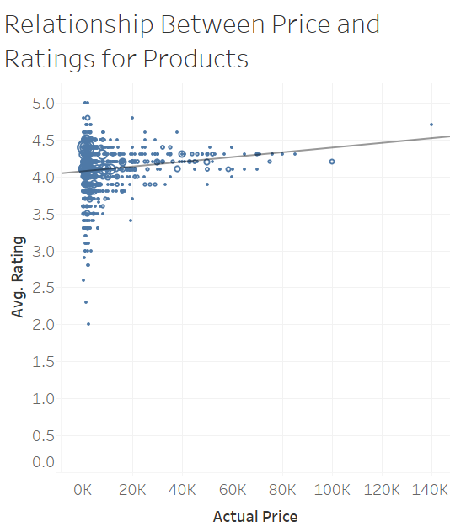
6. Is there a relationship between the discount percentage and the number of reviews or rating?
This scatter plot explores the correlation between actual product prices and their average ratings. The chart provides insights into whether higher-priced items tend to receive better customer ratings, helping to understand consumer behavior and perceived value.

Slide 8
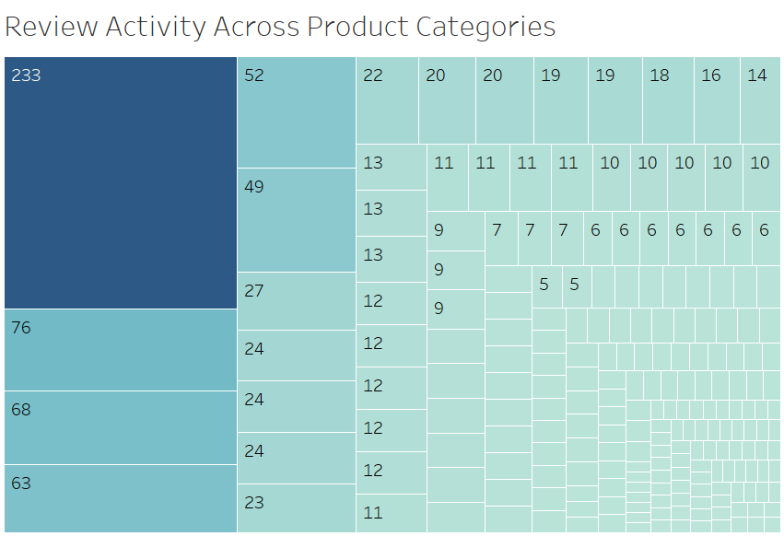
7. Which product categories receive the highest number of reviews, and how do they compare across categories?
This treemap visualizes the distribution of review activity across different product categories on Amazon. The size of each block represents the number of reviews, highlighting the most and least reviewed categories for better insight into customer engagement trends.

Slide 9
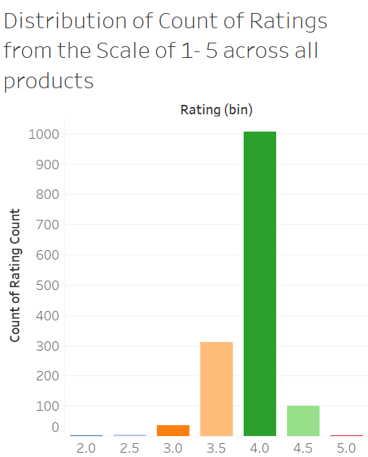
8. How are product ratings distributed across a scale of 1 to 5, and which rating is the most common?
This bar chart displays the count of ratings for products across different rating bins from 1 to 5. It highlights customer feedback trends, with the majority of ratings clustered around 4, indicating general satisfaction with products.

